Slide 1
More search trees
CSS 343: Data Structures, Algorithms, and Discrete Mathematics II
Version 1
Wooyoung Kim

Slide 2
Balanced tree
Worst case complexity of an ordinary binary search tree?
O(n)
Can we achieve O(log n)?
Remain balanced or nearly balanced while updating
Balanced tree
AVL
2-3
B-tree
Etc

Slide 3
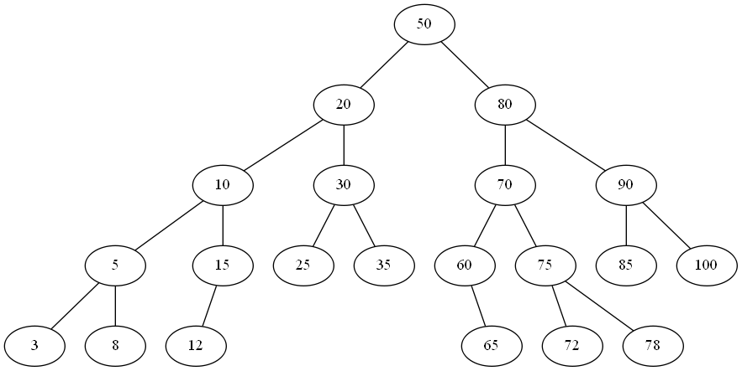
AVL
AVL
Binary search tree AND
For each vertex in the tree, the height of the left and right subtrees differ by at most one
Named after two inventors, Adelson-Velsky and Landis
How about inserting 2?
AVL

Slide 4
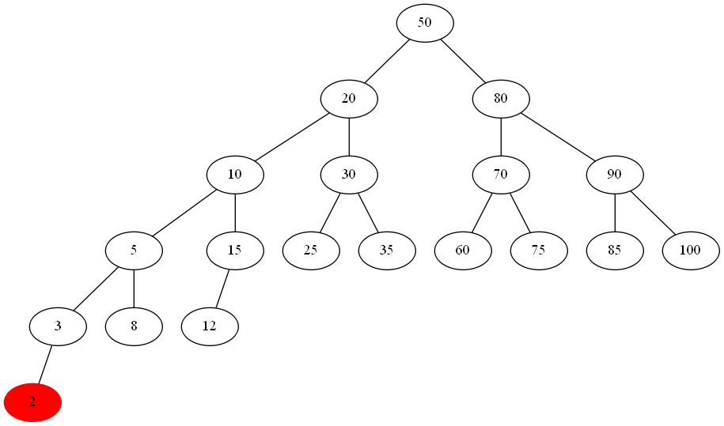
AVL
AVL
Binary search tree AND
For each vertex in the tree, the height of the left and right subtrees differ by at most one
non-AVL
What node is unbalanced one?

Slide 5
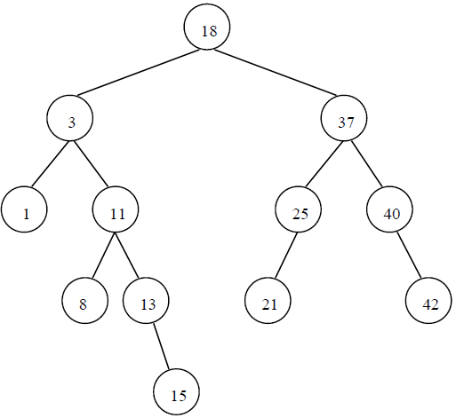
Height - review
Height of a node: between node and its leaf (leaf node’s height is 1)
In program 2: getHeight
keep maximal values (longest path upwards)

Slide 6
Single rotation
Key to AVL: keep it balanced when update is performed
Starting from AVL, four possible insertion cases leading to non-AVL and rotations to fix:
Left-left: insertion in (the left child of the unbalanced vertex)’s the left subtree – single rotation
Right-right: insertion in (the right child of the unbalanced vertex)’s right subtree - single rotation
left-left

Slide 7
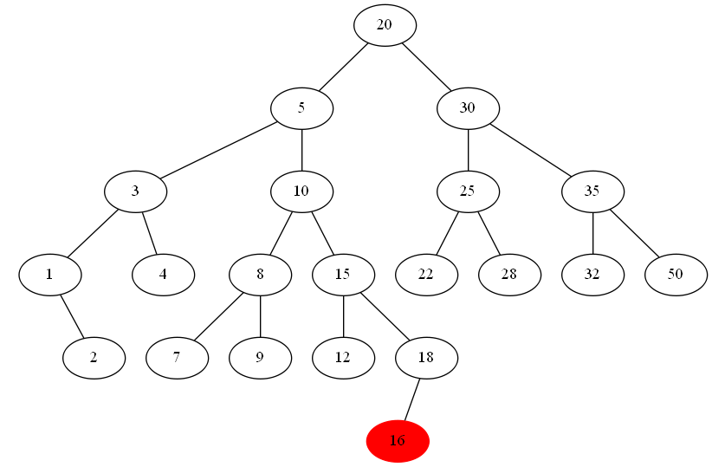
Double rotations
Left-right: insertion in (the left child of the unbalanced vertex)’s right subtree – double rotation
Right-left: insertion in (the right child of the unbalanced vertex)’s left subtree – double rotation
left-right

Slide 8
Practice – which insertion type
After insertion, find the lowest unbalanced vertex
E.g., insert 5:
18
3
25
2
11
23
37
1
8
13
20
28
40
6
10
15

Slide 9
Practice – which insertion type
After insertion, find the lowest unbalanced vertex
E.g., insert 5:
18
Unbalanced vertex: 3
right-left type
3
25
2
11
23
37
1
8
13
20
28
40
6
10
15
5

Slide 10
Steps
Precondition: AVL tree
Step 1: After an insertion, find the lowest unbalanced vertex
Step 2: Identify insertion type
Step 3: Make rotation accordingly

Slide 11
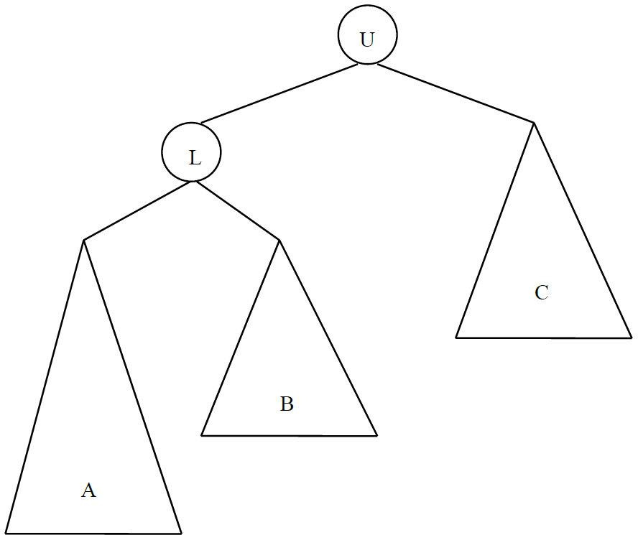
Single rotation
Left-left: find the lowest unbalanced node - U
What is the lowest unbalanced node in the right tree?
20
Because its left subtree is two levels deeper than its right subtree

Slide 12
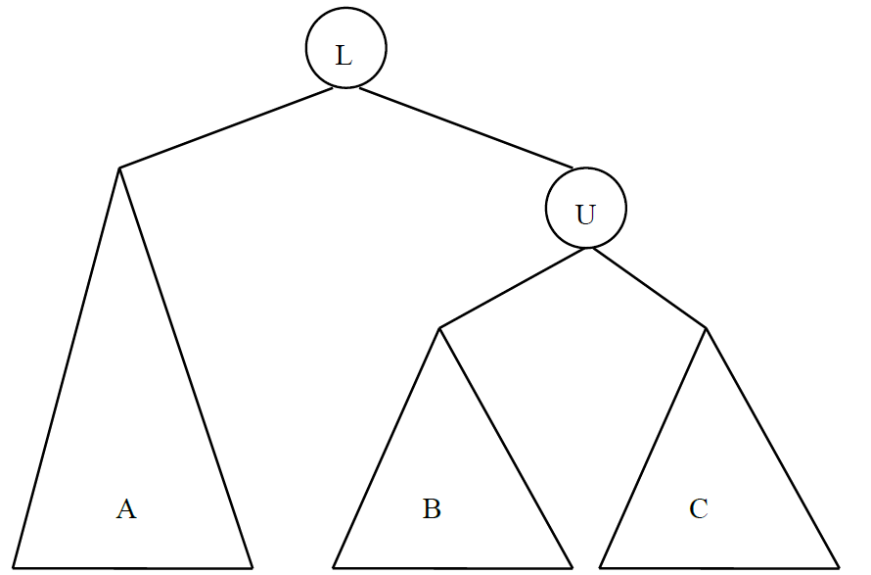
Single rotation
Make to AVL by single rotation

Slide 13
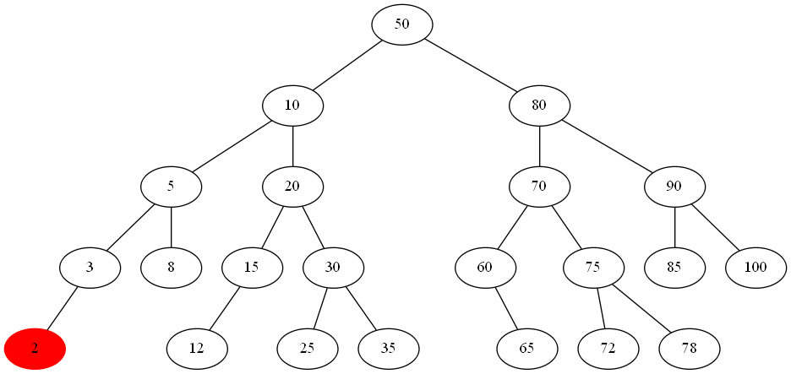
Single rotation
Make to AVL by single rotation
U
L
L
U

Slide 14
Single rotation (cont.)
Right-right: symmetric to left-left

Slide 15
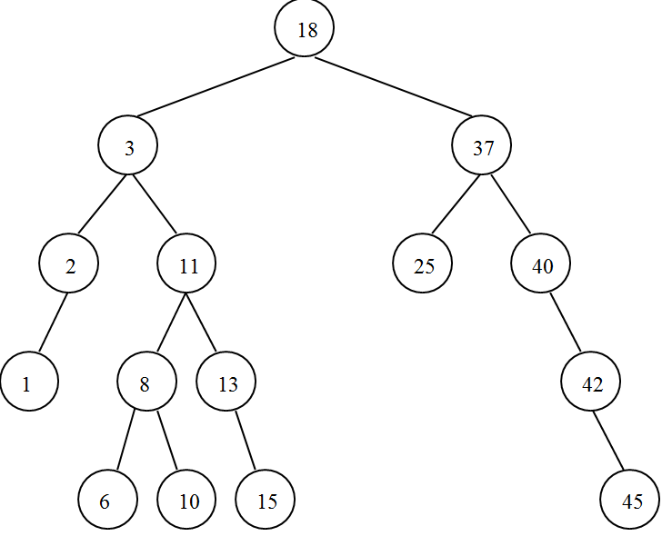
Single rotation - exercise

Slide 16
Double rotation
Left-right
rotation of L with R
rotation U with R

Slide 17
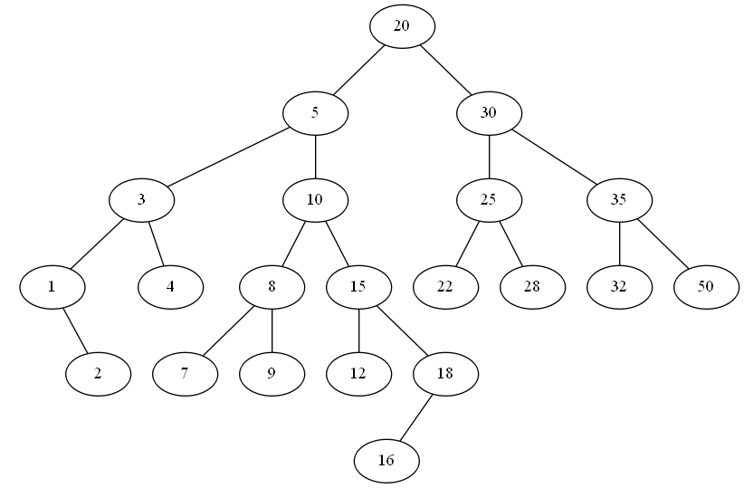
Double rotation-practice
What is U? L? R?

Slide 18
Double rotation-practice
What is U? L? R?
U
L
R

Slide 19
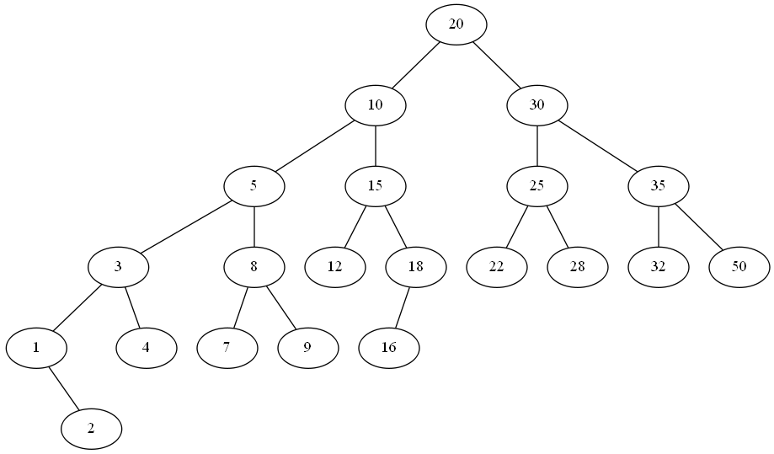
Double rotation-practice
First rotation
U
R
L

Slide 20
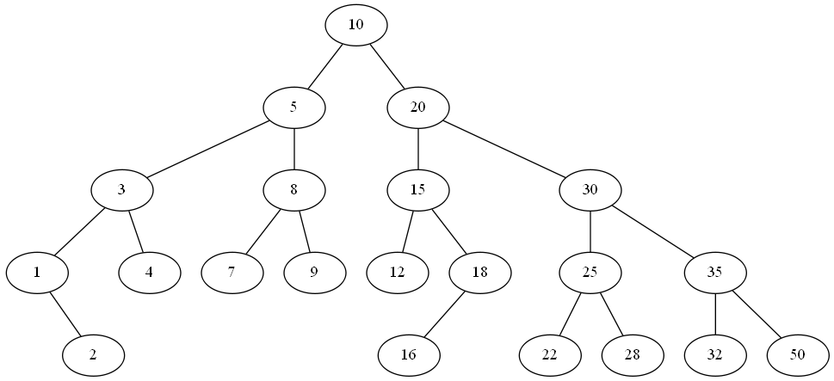
Double rotation-practice
Second rotation
R
L
U

Slide 21
Double rotation
Left-right
Right-left: Mirror of left-right
U
A
R
L
D
B
C

Slide 22
Double rotation
Right-left: Mirror of left-right
U
U
A
L
A
R
B
R
L
D
C
D
B
C
L
U
R
A
B
C
D

Slide 23
Double rotation - exercises
Right-left: Mirror of left-right(See lecture note)

Slide 24
AVL Tree- complexity
The rotation routines are all O(1)
Insertion takes O(log N), when N is the number of nodes, and log N is the height of the tree
Insert: O(log N), requires rotation
Search: O(log N)
Remove: O(log N), requires rotation

Slide 25
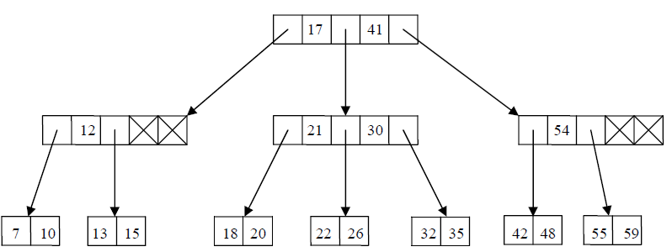
2-3 tree
2-3 tree
Every node with children has either 2 children and one key or three children with two keys
If r has two children, then has one key value
If r has three children, then has two key values
All leaves are at the same depth
Root: either a leaf or has between 2 and 3 children (i.e., tree pointers)
Other non-leaf node: between 2 and 3 children (i.e., tree pointers)
Leaf node: between 1 and 2 key values

Slide 26
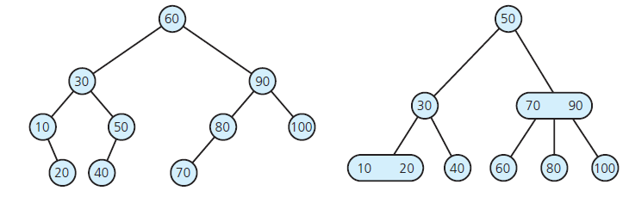
2-3 vs. Binary
2-3 approximately same efficiency as binary
A 2-3 might be shorter, however, need extra time to compare 2 values instead of 1
Why use a 2-3 then?
Maintaining balance is way easier

Slide 27
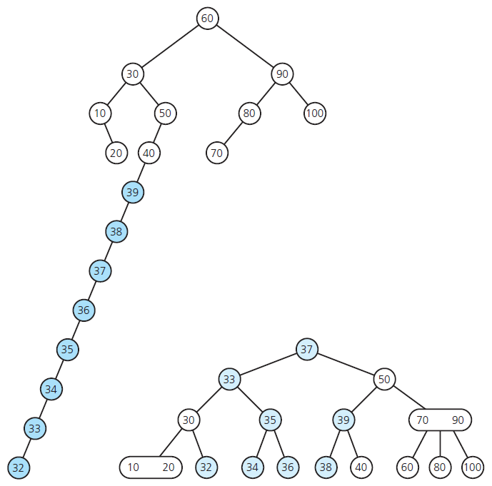
2-3 vs. Binary
Insert 39, 38, 37, …, 32 into previous trees

Slide 28
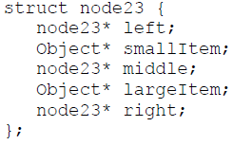
2-3 tree
May or may not keep duplicate values (we use no duplicates)
An insertion: always try the corresponding leaf node first
Not full: quite efficient;
Full: causes a split into two nodes. May propagate to other tree levels (3 children, each node has 2 keys)
What if we need to insert 24? – will revisit it later
A deletion (not covered in this class)
A node does not become less than half full: quite efficient;
Causes a node to become less than half full: it must be merged with neighboring nodes - May propagate to other tree levels
 | S |  | L
left
X<S
right
X>L
middle
S<X<L

Slide 29
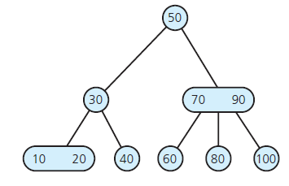
2-3 insertion example
Insert 39 into the tree below

Slide 30
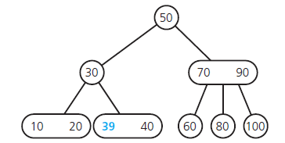
2-3 insertion example
Insert 39 into the tree below
Insert 38 into the tree on the right side

Slide 31
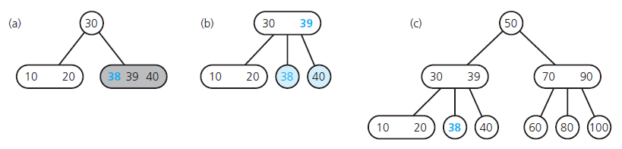
2-3 insertion example
Insert 39 into the tree below
Insert 38 into the tree on the right side
Propagate the middle value to upper node, and split if necessary

Slide 32
Practice 2-3 tree insertion
Insertion sequence: 50, 100, 20, 30, 40, 70, 60, 45, 55, 120, 65, 67, 68, 35, 52, 31, 32
Always try to insert to leaf node
Split rule: promote the middle one
Left: <
Right: >

Slide 33
Example of 2-3 tree insertion
Insertion sequence: 50, 100, 20, 30, 40, 70, 60, 45, 55, 120, 65, 67, 68, 35, 52, 31, 32
Always try to insert to leaf node
Split rule: promote the middle one
Left: <
Right: >
Visualize:
https://www.cs.usfca.edu/~galles/visualization/BTree.html

Slide 34
Example of 2-3 tree insertion
Insertion sequence: 50, 100, 20, 30, 40, 70, 60, 45, 55, 120, 65, 67, 68, 35, 52, 31, 32
50 | 100 | 20
30 |  | 40
50
50
50, 100
20, 50, 100
20
100
50
50
30, 50
20,30
100
20,30, 40
100
20
40
100

Slide 35
Example of 2-3 tree insertion
Insertion sequence: 50, 100, 20, 30, 40, 70, 60, 45, 55, 120, 65, 67, 68, 35, 52, 31, 32
40 | 70
60
30, 50
30, 50
20
40
100
20
40
70, 100
30, 50
30, 50, 70
20
40
60, 70, 100
20
40
60, 100

Slide 36
Example of 2-3 tree insertion
Insertion sequence: 50, 100, 20, 30, 40, 70, 60, 45, 55, 120, 65, 67, 68, 35, 52, 31, 32
60
50
30, 50, 70
30,70
20
40
60, 100
20
40
60, 100
50
50
30
70
30
70
20
40
60, 100
20
40
60
100

Slide 37
Example of 2-3 tree insertion
Insertion sequence: 50, 100, 20, 30, 40, 70, 60, 45, 55, 120, 65, 67, 68, 35, 52, 31, 32
60 | 45
55 | 120
50
50
30
70
30
70
20
40
60
100
20
40, 45
60
100
50
50
30
70
30
70
20
40, 45
55,60
100
20
40, 45
55,60
100,120

Slide 38
Example of 2-3 tree insertion
Insertion sequence: 50, 100, 20, 30, 40, 70, 60, 45, 55, 120, 65, 67, 68, 35, 52, 31, 32
120 | 65
50
50
30
70
30
70
20
40, 45
55,60
100,120
20
40, 45
55,60,65
100,120
50
50
30
60,70
30
60,70
20
40, 45
55,65
100,120
20
40, 45
55
65
100,120

Slide 39
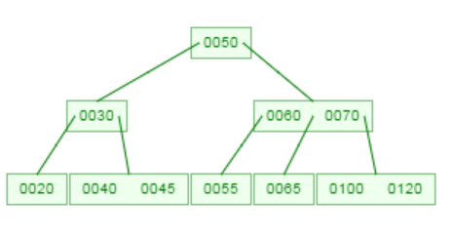
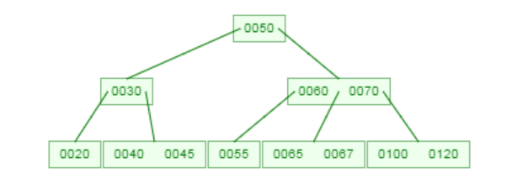
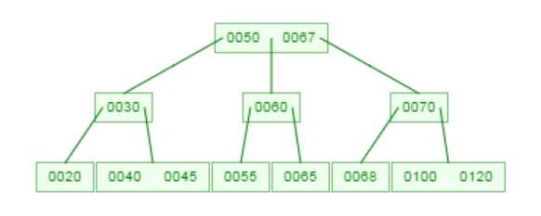
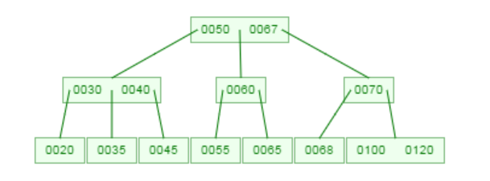
Practice 2-3 tree insertion
Insertion sequence: 50, 100, 20, 30, 40, 70, 60, 45, 55, 120, 65, 67, 68, 35, 52, 31, 32
65
67
68
35

Slide 40
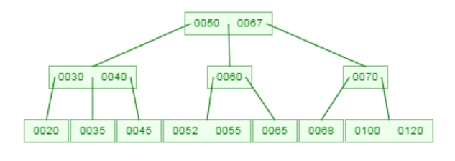
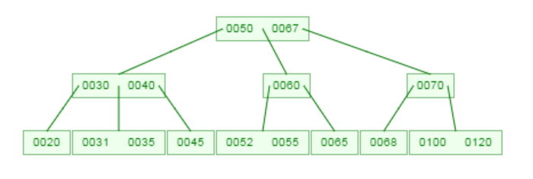
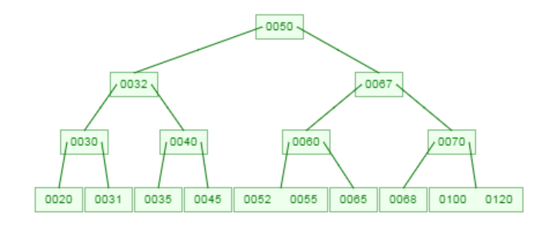
Practice 2-3 tree insertion
Insertion sequence: 50, 100, 20, 30, 40, 70, 60, 45, 55, 120, 65, 67, 68, 35, 52, 31, 32
52
31
32

Slide 41
2-3 tree for 8, 5, 1, 7, 3, 12, 9, 6

Slide 42
2-3 tree for 12, 9, 6, 7, 1, 5, 8, 3

Slide 43
2-3 tree & B tree
2-3 tree: B-tree of order 3
Root: either a leaf or has between 2 and 3 children
Other non-leaf node: between 2 and 3 children
All nodes: between 1 and 2 key values
B tree
All leaves are at the same depth
Balanced tree: of order M
Root: either a leaf or has between 2 and M children (1 and M-1 keys)
Other node is kept between half-full and completely full
# of tree pointers: between ⎡M/2⎤ and M
# of key values: between ⎡M/2⎤ -1 and M -1 (always 1 fewer than # of tree pointers in its same node)
Each node corresponds to a disk block
Big O: search using B-tree vs. AVL?

Slide 44
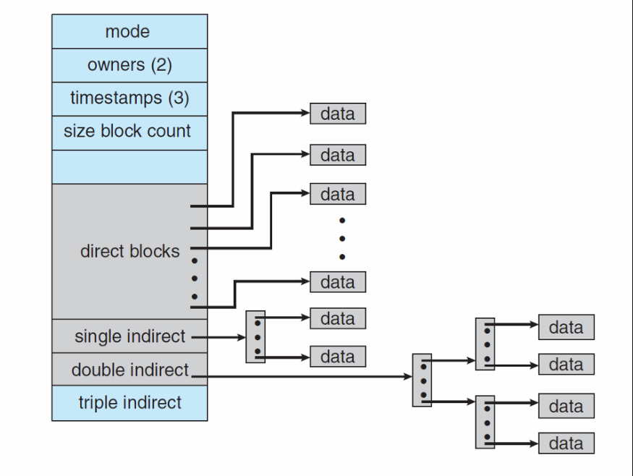
Consider the following problem
We’ll introduce B+ Trees in the context of an application
A file system on disk
A dictionary has a lot of data, most of it is on disk
It is desirable to have a balanced tree (logarithmic height) that is even shallower than AVL trees so that we can minimize disk accesses and exploit disk-block size
key idea: Increase the branching factor of our tree

Slide 45
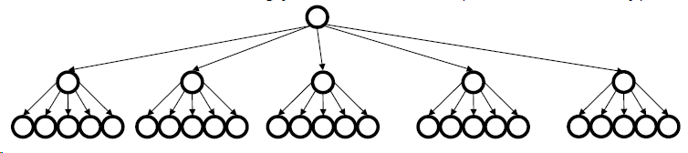
M-ary Search Tree
Build some sort of search tree with branching factor M:
Have an array of sorted children (Node[])
Choose M to fit snugly into a disk block (1 access for array)
Number of “hops” for find
In a balanced M-ary tree, approx. log_{M} n instead of log₂ n
Example M=256 = 2^8 and n=2^40 this is 5 hops instead of 40
But how to choose which branch to take?
In BST is just < or >, how do we approach M-ary? Do we use ranges?
In a balanced M-ary tree find’s runtime is O(log₂ M log_{M} n)= O(log₂ n) why?
log_{M} n is the traversed height
log₂ M At each step, find the correct child branch to take using binary search among the M options!
, assume root level = 0

Slide 46
In the context of the disk application…
What should the order property be?
How would you rebalance (ideally without more disk accesses)?
Storing real data at inner-nodes (like we do in a BST) seems kind of wasteful…
To access the node, will have to load the data from disk, even though most of the time we won’t use it!!
Usually we are just “passing through” a node on the way to the value we are actually looking for.
Use the branching-factor idea, but for a different kind of balanced tree:
Not a binary search tree
But still logarithmic height for any M > 2

Slide 47
B+ Trees
Two types of nodes: internal nodes & leaves
Each internal node has room for up to M-1 keys and M children
No other data; all data at the leaves!
Order Property
Subtree between keys a and b contains only data that is >= a and < b
Leaf nodes have up to L sorted data items
Searching through the tree is still an easy recursive algorithm from the root
At each internal node, binary-search up to M-1 keys to find the branch
At the leaf, binary-search up to L data items
To get log run time we still need to balance!
Note Subtle difference in literature!
“B Trees” can store both keys and data in internal nodes
In B+ Trees data can only be stored at the leaves

Slide 48
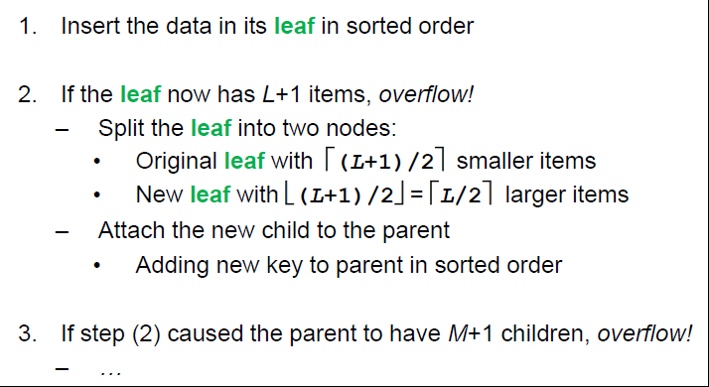
Insertion algorithm

Slide 49
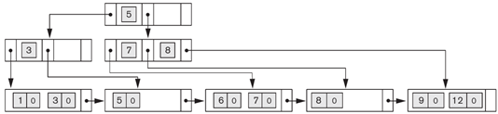

B+ tree properties
Internal node order Pint
# of tree pointers: ⎡P_{int}/2⎤ ~ Pint
# of key values: ⎡P_{int}/2⎤-1 ~P_{int}-1 key values (only “virtual” data)
data pointers?
None! (not real data entries)
In a node: Smaller data to the left, bigger right
Tree branches: left_{i} <= key_{i}; key_{i}<right_{i}<=key_{i+1}
Root: at least 2 tree pointers if not leaf
Leaf node order Pleaf (all “real” data stored in leaves)
# of data pointers: ⎡P_{leaf}/2⎤ ~ Pleaf
# of key values: ⎡P_{leaf}/2⎤ ~ Pleaf (“real” data)
Tree pointers?
1 tree pointer to next leaf

Slide 50
Example of B+ tree insertion
Insertion sequence: 8, 5, 1, 7, 3, 12, 9, 6
When Pint (M) = 3 and Pleaf (L)= 2
Always insert to leaf node, all real data stay at leaf
Split rule: “promote” the middle “virtual” value
Left: leaf node <= upper level key; internal node < upper level key
Right: >
Practice:
How about 12, 9, 6, 7, 1, 5, 8, 3?
How about 1, 5, 7, 3, 8, 12, 9, 6?

Slide 51
B+ tree insertion
8, 5, 1, 7, 3, 12, 9, 6 (M=3, L=2)
8,5 | 1 | 7
3
5
5
5,8
1, 5, 8
1,5
8
1,5
7, 8
5
3, 5
1,3, 5
7, 8
1,3
5
7, 8

Slide 52
B+ tree insertion
8, 5, 1, 7, 3, 12, 9, 6 (M=3, L=2)
12 | 20
9 | 6
5
3, 5
3, 5, 8
3
8
1,3
5
7, 8,12
1,3
5
7, 8
12
1,3
5
7, 8
12
5
5
3
8
3
7,8
1,3
5
7, 8
9, 12
1,3
5
6,7
8
9, 12

Slide 53
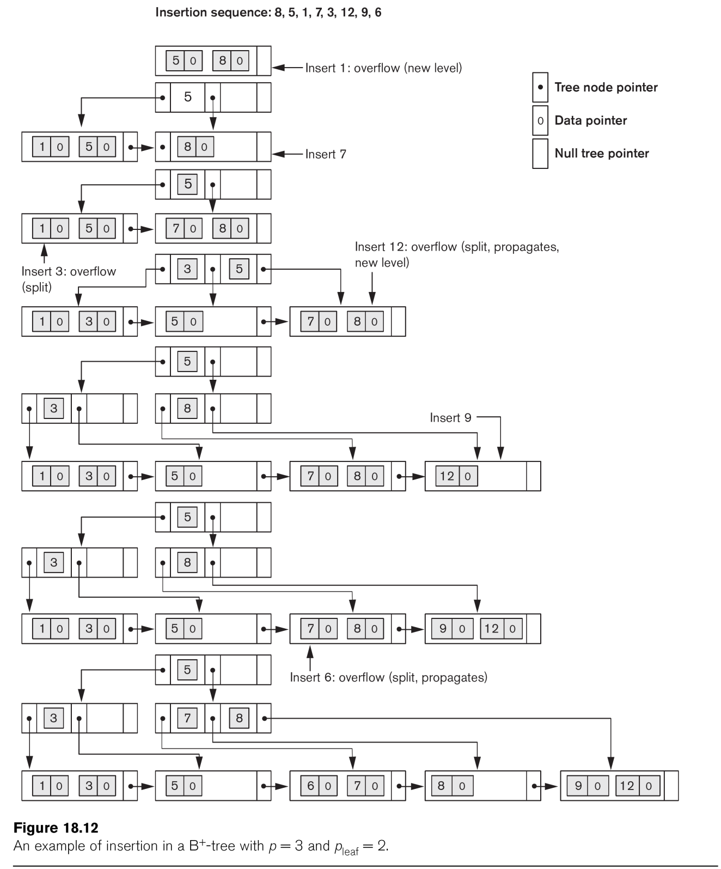
Example of an Insertion in a B+ tree

Slide 54
Exercise : B+ tree insertion (Pint (M)=3, Pleaf (L) =2)
Note that the left child's key <= parent's key. Also, in the leaf, if there are 3 keys, copy the middle key to the parent node.
12, 9, 6, 7, 1, 5, 8, 3
1, 5, 7, 3, 8, 12, 9, 6

Slide 55
What if Pint (M) = 3 and Pleaf (L)= 3

Slide 56
B+ tree insertion
8, 5, 1, 7, 3, 12, 9, 6 (M=3, L=3)
8,5, 1 | 7 |  | 3
12 |  | 9
5
5
1,5,8
1, 5, 7, 8
1,5
7, 8
1,3, 5
7, 8
5
5
1,3, 5
7, 8, 12
1,3, 5
7, 8, 9, 12

Slide 57
B+ tree insertion
8, 5, 1, 7, 3, 12, 9, 6 (M=3, L=3)
9
6
5
5, 8
1,3, 5
7, 8, 9, 12
1,3, 5
7,8
9, 12
5, 8
1,3, 5
6, 7,8
9, 12

Slide 58
Exercise : B+ tree insertion (Pint (M)=3, Pleaf (L) =3)
Note that the left child's key <= parent's key. Also, in the leaf, if there are 4 keys, copy the second key to the parent node.
12, 9, 6, 7, 1, 5, 8, 3
1, 5, 7, 3, 8, 12, 9, 6
Notes:
5,7 -→ 1,3,5 || 6,7 || 8,9,12
3,7 -→ 1,3|| 5, 6,7 || 8,9,12

Slide 59
Example
So how do we pick M and L (P_{int} and P_{leaf})?
Depends on the application, in our example, it would be based on the disk-block size

Slide 60
Back to disk application example
What makes B+ trees appropriate for such an application?
Many keys stored in one internal node
All brought into memory in one disk access
IF we pick M wisely
Makes the binary search over M-1 keys totally worth it (insignificant compared to disk access times)
Internal nodes contain only keys
Any find wants only one data item; wasteful to load unnecessary items with internal nodes
So only bring one leaf of data items into memory

Slide 61
Application Example (disk)
Consider the application of B + trees for directories. Suppose that you are given a B+tree with parameters (P_{int}) M=11 and (P_{leaf}) L=8. Determine the approximate size of a disk block on the machine where this implementation would be used, assuming you also have the following information:
Key Size =8 Bytes
Pointer (tree or data) Size = 4 Bytes
Give a numeric answer showing all the steps taken to arrive to your answer (Compute the possible sizes of both internal and leaf nodes). In addition, give a short explanation using the parameters given and the equations.
Determine the internal node size
Determine leaf node size
Determine the size of a disk block

Slide 62
Application Example (disk)
Consider the application of B + trees for directories. Suppose that you are given a B+tree with parameters (P_{int}) M=11 and (P_{leaf}) L=8. Determine the approximate size of a disk block on the machine where this implementation would be used, assuming you also have the following information:
Key Size =8 Bytes
Pointer (tree or data) Size = 4 Bytes
Give a numeric answer showing all the steps taken to arrive to your answer (Compute the possible sizes of both internal and leaf nodes). In addition, give a short explanation using the parameters given and the equations.
Determine the internal node size
(M-1) keys + M tree pointers = 10*8 + 11* 4 = 124 byte
Determine leaf node size
L keys+ L data pointer + 1 tree pointer = 8*8 + 8*4 + 1*4 = 100 byte
Determine the size of a disk block
Each block is supposed to have one node. So max(124, 100) = 124 byte

Slide 63
Difference between B tree and B+ tree
B tree (order of M)
Data pointers: in all levels
Tree pointers: in all levels (leaf nodes tree pointers are null)
B+ tree (Pint, Pleaf)
Data pointers: only the leaf-level
Tree pointer: non-leaf levels & 1 tree pointer in each leaf node
In general, which can support more efficient retrieval? B tree or B+ tree?

Slide 64
B tree vs. B+ tree
Assume each node in B tree and B+ tree is full, which one (B tree or B+ tree) can store more data for a tree of depth 3
Assume
Disk block size D = 512
Key value size K = 2
Pointer size (tree pointer, data pointer) P = 1
Calculate M (order for B tree): roughly
Calculate Pint & Pleaf for B+ tree: roughly

Slide 65
B tree vs. B+ tree
Assume each node in B tree and B+ tree is full, which one (B tree or B+ tree) can store more data for a tree of depth 3
Assume
Disk block size D = 512
Key value size K = 2
Pointer size (tree pointer, data pointer) P = 1
Calculate M (order for B tree): roughly
Calculate Pint & Pleaf for B+ tree: roughly
Each node needs size: M tree pointer + (M-1) * (key values and data pointers)
M * 1 + (M-1)* (2+1) = 4M-3<=512. therefore, M <=128
Therefore, # data = 1 *127(root) + 128*127 (second level) + 128 *128*127 (third level) = 2,097,151
Each internal node: Pint * tree pointer + (Pint-1) keys
Pint*1 + (Pint-1) * 2 = 3 Pint -2 <=512, Pint <=171
Each leaf node: Pleaf * (key + data pointer) + 1 tree pointer
Pleaf *3 +1 <=512, Pleaf<=170
Therefore, # data = 0 (root) + 0 * 171 (second level) + 171*171*170 (leaves) = 4,970,970

